Slide 1

Professional Practices (HUM-305)
SPRING SEMESTER 2026
By
Prof Engr Muhammad Raheel Iqbal Butt
Resource Person
Contact: +92 321 7433568
School of Computer & Information Technology
Beaconhouse National University, Lahore

Slide 2


Slide 3
Chap 11: Code of Conduct
Computer Society Code of Conduct,
IEEE Code of Ethics,
ACM Code of Ethics
Professional Conduct

Slide 4


Slide 5
Computer Society Code of Conduct (IEEE Computer Society)
Introduction
The IEEE Computer Society provides a Code of Conduct for computing professionals.
It ensures ethical behavior, professionalism, and accountability in the computing field.
Key Principles
Integrity: Be honest and trustworthy in all professional activities.
Competence: Maintain and improve technical knowledge and skills.
Responsibility: Accept responsibility for your work and its impact.
Respect for Privacy: Protect confidential and personal data.
Avoid Harm: Ensure systems do not harm individuals or society.

Slide 6
Computer Society Code of Conduct (IEEE Computer Society)
Professional Behavior
Avoid conflicts of interest.
Do not misuse company or client resources.
Follow laws, policies, and organizational rules.
Importance
Builds trust in computing professionals.
Promotes safe and reliable technology use.
Encourages accountability in software development.

Slide 7


Slide 8
2. IEEE Code of Ethics
Introduction
Developed by the IEEE.
Applies to engineers, technologists, and computing professionals worldwide.
Core Ethical Principles
Public Safety First
Protect health, safety, and welfare of the public.
Honesty and Transparency
Be truthful in claims, reports, and data.
Avoid Conflicts of Interest
Disclose any potential conflicts honestly.

Slide 9
2. IEEE Code of Ethics
Reject Corruption
Avoid bribery and unethical financial practices.
Professional Responsibilities
Improve understanding of technology and its consequences.
Treat all individuals fairly regardless of background.
Accept criticism and correct errors.
Key Value
Focuses strongly on societal impact and public welfare.

Slide 10


Slide 11
3. ACM Code of Ethics
Introduction
Developed by the Association for Computing Machinery.
Widely used in software engineering and IT professions.
General Ethical Principles
Contribute to society and human well-being.
Avoid harm to others.
Be honest and trustworthy.
Respect privacy and confidentiality.
Professional Responsibilities
Deliver high-quality work.
Maintain professional competence.
Follow laws and organizational policies.
Respect intellectual property rights.

Slide 12
3. ACM Code of Ethics
Leadership Responsibilities
Promote ethical practices in organizations.
Ensure systems are safe and secure.
Support ethical decision-making within teams.
Compliance
Members must follow the code.
Violations can lead to disciplinary action.

Slide 13


Slide 14
4. Professional Conduct
Definition
Professional conduct refers to behavior, attitude, and ethics expected from professionals in the workplace.
Key Elements
Integrity: Always act honestly.
Accountability: Take responsibility for actions.
Confidentiality: Protect sensitive information.
Respect: Treat colleagues and clients fairly.
Discipline: Follow organizational rules and standards.

Slide 15
4. Professional Conduct
Workplace Behavior
Punctuality and commitment.
Proper communication and teamwork.
Avoid harassment or discrimination.
Ethical Decision Making
Identify the problem.
Consider stakeholders.
Evaluate alternatives.
Choose the most ethical option.
Importance
Builds a positive work environment.
Enhances organizational reputation.
Ensures long-term career success.

Slide 16


Slide 17
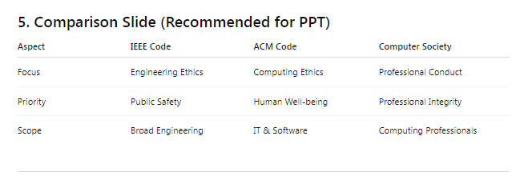

Slide 18
Conclusion
Ethical codes guide professionals in making responsible decisions.
Organizations like IEEE and Association for Computing Machinery set global standards.
Following these codes ensures:
Trust
Safety
Professional growth

Slide 19


Slide 20


